Slide 1
Introduction to Clustering

Slide 2
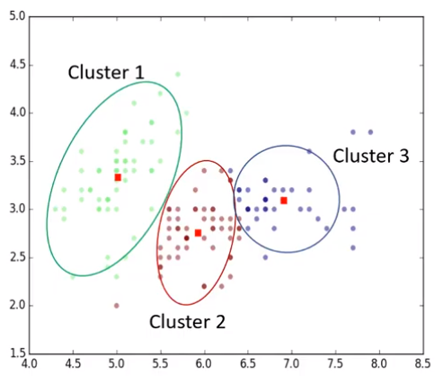
What is clustering ?
Clustering means finding clusters in a dataset, unsupervised.
So, what is a cluster?
A cluster is group of data points or objects in a dataset that are similar to other objects in the group, and dissimilar to data points in other clusters.

Slide 3
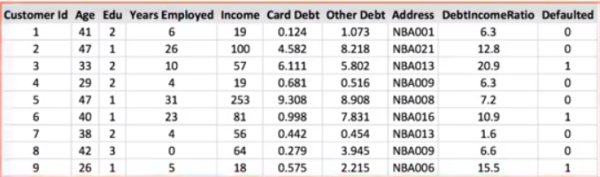
Imagine that you have a customer dataset, and you need to apply customer segmentation on this historical data.
Customer segmentation is the practice of partitioning a customer base into groups of individuals that have similar characteristics.
This helps business to target specific groups of customers (ex: high profit & low risk customers or non-profile organization customers) by to more effectively allocating marketing resources.

Slide 4
A general segmentation process is not usually feasible for large volumes of varied data.
Therefore, you need an analytical approach to deriving segments and groups from large data sets.
Customers can be grouped based on several factors: including age, gender, interests, spending habits, and so on.
The important requirement is to use the available data to understand and identify how customers are similar to each other.
One of the most adopted approaches that can be used for customer segmentation is clustering.

Slide 5
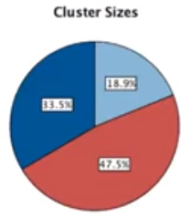
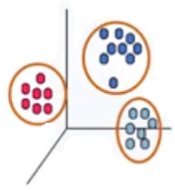
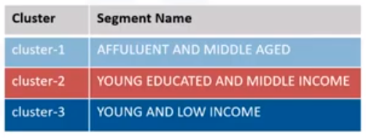
Clustering can group data only “unsupervised,” based on the similarity of customers to each other.
It will partition your customers into mutually exclusive groups, ex: into 3 clusters.
The customers in each cluster are similar to each other demographically.
Now we can create a profile for each group, considering the common characteristics of each cluster.

Slide 6
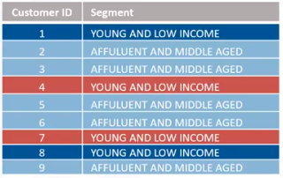
Finally, we can assign each individual in our dataset to one of these groups or segments of customers.

Slide 7
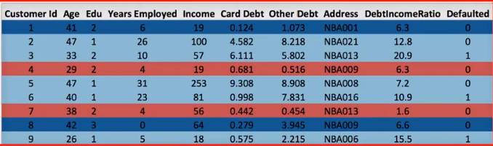
When we cross-join this segmented dataset, with the dataset of the product or services that customers purchase from our company, it would really help us to understand and predict the differences in individual customers’ preferences and their buying behaviors across various products, allowing your company to provide highly personalized experiences for each segment.

Slide 8
Applications
Customer segmentation is one of the popular usages of clustering.
Cluster analysis also has many other applications in different domains.
Retail/Marketing
Based on customer’s demographic characteristics, identifying buying patterns of customer groups
Recommending new books or movies to customers
Banking
Find clusters of normal transactions to find pattern of fraudulent credit card usage.
Identify clusters of customers to find loyal customers versus churn customers.

Slide 9
Insurance
Analyse genuine claim clusters to identify false claim fraud.
Evaluate insurance risk of customers based on their segments
Publication
Clustering is used to auto-categorize news based on its content,
Tag news, then cluster it, so as to recommend similar news articles to readers
Medicine
Characterize patient behaviour, based on their similar characteristics, so as to identify successful medical therapies for different illnesses.

Slide 10
Where Clustering can be used ?
Clustering can be used for one of the following purposes:
Exploratory data analysis
Summary generation or reducing the scale
Outlier detection, especially to be used for fraud detection
Noise removal
Finding duplicates in datasets
Pre-processing step for either prediction, other data mining tasks
Part of a complex system.

Slide 11

Please contact
Foundation for Innovation and Collaborative
Education
mentor@fice.in
www.fice.in
Please contact
Foundation for Innovation and Collaborative
Education
info@fice.in
mentor@fice.in
Notes:
Here are the lessons we are going to learn today.

